Slide 2
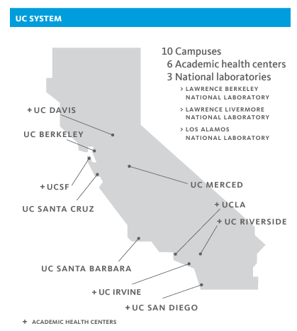
Welcome to the University of California (UC)
https://ucop.edu/institutional-research-academic-planning/_files/uc-facts-at-a-glance.pdf

Slide 3
UCLA Programs
UCLA is home to the College and 12 Professional Schools
The College comprises five Divisions: Humanities, Life Sciences, Physical Sciences, Social Sciences, and Undergraduate Education
The Professional Schools focus on fields of study ranging from the Arts to Medicine
UCLA is home to the Semel Institute for Neuroscience & Human Behavior, established in 2004

Slide 4
Welcome to the UCLA Semel Institute for Neuroscience and Human Behavior
Mission: To improve the mental health and wellbeing of the people of California and throughout the world through education and training, translational research, and advancements in clinical care.
https://www.semel.ucla.edu/semel

Slide 5
Semel History
Origins in the Neuropsychiatric Institute (NPI) and the Neuropsychiatric Hospital (NPH), which opened their doors in 1961
These facilities were dedicated to research, education, and clinical care for those suffering from chronic psychiatric and neurological disease and behavioral disorder
Initially, support was fully from the California Department of Mental Hygiene
In 1973, the NPI resources were transferred to UCLA
In 2004, with the endowment of the Institute and Hospital, the Jane & Terry Semel Institute for Neuroscience & Human Behavior was established

Slide 6
Semel Institute Structure
Helena Hansen Interim Director, Semel Institute Interim Exec. Chair, Dept. of Psychiatry Interim Physician-in-Chief, RNPH
Catherine Hampel Psychiatry CAO
Patricia Lester Exec. Vice Chair, Dept. of Psychiatry
Amy Ragsdale CAO
Mirella Dapretto Associate Director, Semel Institute
Monica Rodriguez Interim COO
Research Centers
Clinical Divisions
Autism Daniel Geschwind
Brain Mapping Roger Woods
Cognitive Neuroscience Robert Welsh
Adult Psychiatry Michael Gitlin
Community Health Scott Comulada
Health Services & Society Elizabeth Bromley
Intellectual & Developmental Disabilities (IDDRC) Harley Kornblum
Child & Adolescent Psychiatry Suma Jacob
Integrated Substance Abuse Programs (ISAP) Christine Grella
Mass Spec Lab Kym Faull
Math Models Sally Blower
Geriatric Psychiatry Michael Gitlin
Psychology Robert Bilder
Neurobehavioral Genetics Nelson Freimer
Neuroimaging & Addiction Treatment Edythe London
Neuropharmacology (Hatos Center) Chris Evans
Neuromodulation Andrew Leuchter
Psychoneuroimmunology (Cousins Center) Michael Irwin
Section on Psychosis Steve Marder
Sleep Research Jerome Siegel
Population Behavioral Health Patricia Lester
Social Medicine & Humanities Philippe Bourgois
Statistics Core Catherine Sugar
Trauma Center Robert Pynoos
Hispanic Neuropsychiatric Ctr of Excellence (HNCE) Xavier Cagigas

Slide 7
Semel Institute Administration
Semel has 9 central offices to help the Faculty and administrators manage their portfolios:
OFFICE | ROLE
Academic Payroll | Assists with Faculty payroll and vacation leave processing
Academic Personnel Office | Assists with personnel actions related to academic titles
Academic Trainee Office | Assists with personnel actions related to postdocs & GSRs
Finance | Maintains stewardship of department’s (non-C&G) financial resources
Human Resources | Assists with personnel actions related to staff
Information System Group | Provides IT-related support
Office of Extramural Support (OES) | Provides C&G post-award support
Office of Research Opportunity & Strategy (OROS) | Provides pre-award support and training
Space | Manages issues related to facilities and space

Slide 8
Acronyms
AO | Authorized Official
DCR | Distribution Change Request
EFM | Extramural Fund Management
ERS | Effort Report System
IRB | Institutional Review Board
JIT | Just-In-Time
NIH | National Institutes of Health
NOFO | Notice of Funding Opportunity
OCGA | Office of Contract & Grant Administration
PI | Principal Investigator
PMCID | PubMed Central Identifier vs PMID – PubMed Identifier
RPC | Research Policy & Compliance
Find more commonly used acronyms here: https://oes.semel.ucla.edu/faq/#more-377

Slide 9
Division/Center Administrator
Provide administrative support to PI/Center/Division
Plan and track pre- and post-award actions
Serve as a liaison between the PI and central offices
In some cases, assist with project management
Advise your PIs regarding policy and help guide them in achieving their goals

Slide 10
Academic Payroll
Notes:
We strive to offer sponsored research projects with accurate, reliable, and timely post-award services using the latest policies and guidelines to advance our Institute’s mission.

Slide 11
Role of Academic Payroll
To manage payroll information for Academic Titles
Collaborate with Finance and OES on approvals related to Faculty DCRs
To process transactions in UCPath
Collaborate with the Academic Personnel Office on processing merit/payroll-related actions

Slide 12
Academic Payroll in the FY
Academic Payroll works with Finance and Academic Personnel to prepare Faculty Compensation Worksheets (FCW) for distribution
Salary negotiations for the upcoming FY kick off in January each year
In June, Academic Payroll staff manually enter approved FCWs into UCPath
In October, Academic Payroll staff manually update distributions in UCPath to reflect merit increases
Throughout the FY, Academic Payroll reviews and processes Faculty Distribution Change Requests (DCR) and merit increases

Slide 13
Faculty DCR
Throughout the year, a faculty member may receive new awards or rebudget existing awards that require a change to their salary distribution
To request such a change, a Division/Center Administrator must:
log into the Faculty DCR portal and download the faculty member’s payroll sheet
on the 1st tab of the sheet, copy the existing distribution directly below and make desired changes
if the request is retroactive, enter responses for the cost transfer questions
route the DCR to fund managers for funding approval
sign the DCR, obtain Faculty member’s signature, and upload to the portal along with backup documents

Slide 14
DCR Backup Documents
A Teaching Effort Reduction form needs to be completed and submitted if a faculty member would like to reduce their teaching effort in order to increase effort on other activities
FTE holders must contribute 15% of their effort to teaching
Non-FTE holders must contribute 10% of their effort to teaching
A Salary Savings request memo needs to be completed and submitted if an FTE holder would like to save 19900 funds by charging other sources

Slide 15
Vacation Leave Reporting
Every 1st business day of the month, Academic Payroll emails Faculty and Non-Faculty a reminder to report their prior month leave usage via Qualtrics.
Academic Payroll downloads the leave usage report from Qualtrics the 10th of every month and, to capture last-minute reporting, revisits before the “Manage Accruals transaction” cut off date: (https://ucpath.universityofcalifornia.edu/pages/payroll-processing-schedules-working-hours)
Faculty and Non-Faculty can view leave balances on their UCPath account/portal: https://ucpath.universityofcalifornia.edu/
Academic Payroll will report the leave usage via UCPath, after ensuring NO duplicate entries are submitted and leave accrual is sufficient
Leave accruals not yet earned cannot be used (unless approved by UC leadership like Holiday break)
NOTE: Reporting vacation hours credits faculty/non-faculty salary funding sources. Timely submission of leave usage reports is essential to ensure that these vacation credits are posted to the appropriate accounts in the following month without delays.

Slide 16
Academic Payroll Organizational Chart
Psychiatry CAO Catherine Hampel
Associate Chair for Academic Affairs Tara Peris
Manager Arnel Concepcion
Academic HR Analyst 3 TBA
Payroll Supv 1 TBA
Payroll Analyst 2 Emily Sanchez
Payroll Analyst 2 Julia Chan

Slide 17
Academic Payroll Directory
Name | Role | Email
Arnel Concepcion | Primary contact for Academic Payroll matters Managing Faculty L-O | AAConcepcion@mednet.ucla.edu
Julia Chan | Managing Faculty’s last name P-Z | JuliaChan@mednet.ucla.edu
Emily Sanchez | Managing Faculty’s last name D-K | EmilySanchez@mednet.ucla.edu
Helen Li, (affiliate) | Managing Faculty A-C (temp) | HelenLi@mednet.ucla.edu

Slide 18
Academic Personnel Office (APO)
Notes:
We strive to offer sponsored research projects with accurate, reliable, and timely post-award services using the latest policies and guidelines to advance our Institute’s mission.

Slide 19
Role of the Academic Personnel Office (APO)
To collaborate with Centers/Divisions and Semel Leadership on faculty recruitments
Coordinate reviews, annual reappointments, and recalls for faculty and other academic titles (professorial series, professional researchers, project scientists, etc.)
Coordinate Visa applications (J-1, H-1B, O-1, etc.)
Collaborate with the Academic Payroll unit on processing merit/payroll-related actions
Onboarding for newly hired academic personnel

Slide 20
APO Appointment Types
Professorial Series: in-Residence, Health Sciences, Adjunct, Clinical “X”
Research Series: Professional Researchers*, Project Scientists*, Specialists
Academic Coordinator or Academic Administrator
Voluntary Clinical Professor Series
*https://ucnet.universityofcalifornia.edu/labor/bargaining-units/ra/contract.html

Slide 21
General Criteria for Appointment/Review*
Teaching
Research
University and/or Public Service
Professional Clinical Activities
Administration
* Criteria varies by series

Slide 22
Academic Salary Scales
Professorial Series salary scale
Scale 3 is for Basic Scientists
Scale 5 is for Clinicians
Researcher Series salary scale
Project Scientist Series salary scale
Rank is determined by degree award date, scholarly experience, teaching, publication record, contract & grant portfolio
Within each Series, there are the following Rank & Steps
Assistant (1 – 4)
Associate (1 – 3)
Full (1 – 9)

Slide 23
APO Organizational Chart
Psychiatry CAO Catherine Hampel
Associate Chair for Academic Affairs Tara Peris
Special Projects Lorinda Murdock-Lane
Supervisor Kyna Williams
Sr. Analyst TBA
Sr. Analyst Amanda Mehl
Analyst Jennifer Calhoun
Analyst Paulina Contreras
Analyst Marissa Vela

Slide 24
APO Directory
Name | Role | Email
Kyna Williams | Primary contact for Academic Personnel matters | KLWilliams@mednet.ucla.edu
Lorinda Murdock-Lane | Special projects / Academic Personnel consultant | LMurdock@mednet.ucla.edu
TBA | Dossier preparation (A-L), VCP Coordinator
Amanda Mehl | Dossier post auditing, new appointments, UC Recruit transaction | AMehl@mednet.ucla.edu
Jennifer Calhoun | VCP Coordinator | JCalhoun@mednet.ucla.edu
Paulina Contreras | Responsible for UCPath entries | PContreras@mednet.ucla.edu
TBA | Assistant to Associate Chair of Academic Affairs, VCP Coordinator

Slide 25
Academic Trainee Office (ATO)
Notes:
We strive to offer sponsored research projects with accurate, reliable, and timely post-award services using the latest policies and guidelines to advance our Institute’s mission.

Slide 26
Role of the Academic Trainee Office (ATO)
Serve as personnel office for research trainees for the department. Coordinate onboarding for newly appointed trainees and other personnel actions.
Counsel all incoming trainees on UCLA and Semel Institute policies and procedures, benefits elections, and any HR related questions.
Provide support and advisement to department administrators and faculty regarding union contracts, policies, and procedures.
Coordinate trainee visa sponsorship applications (J-1 and H-1B)
Serve as the main departmental liaison between the Semel Institute and Division of Graduate Education, Campus Human Resources- Benefits Office, Campus Payroll, Deans Visa Office, UCLA Center for GSR’s

Slide 27
ATO Population Types
Postdoctoral Scholars (Postdoc):
Titles codes:
Postdoctoral Scholar- Employee TC 3252- An appointment is made in the title “Postdoctoral Scholar – Employee” when a. the agency funding the salary requires or permits the appointee to be an employee of the University, or b. whenever General Funds, Opportunity Funds or other University discretionary funds are used to support the position.
Postdoctoral Scholar- Fellow TC 3253- Postdoctoral Scholar has been awarded a fellowship or traineeship for postdoctoral study by an extramural agency and the fellowship or traineeship is paid through a University account.
Postdoctoral Scholar- Paid Direct TC 3254- Postdoctoral Scholar has been awarded a fellowship or traineeship for postdoctoral study by an extramural agency and the agency pays the fellowship or traineeship directly to the Postdoctoral Scholar, rather than through the University. Such appointments shall have a “without-salary” status.
Salary scale and PD levels: Postdocs – Office of Education (ucla.edu)

Slide 28
ATO Population Types
Graduate Student Researchers (GSRs):
Title codes:
Graduate Student Researcher- Employee TC 3276- Graduate student who performs research as a condition of receiving financial remuneration from funding generated by the University, provided that the graduate student is performing this funded research under the specific direction of a faculty member or authorized Principal Investigator.
Graduate Student Researcher- Fellow TC 3145- (E.g. NSF GRFP, NIH F30, F31, F31-Diversity) Student who obtains individual fellowship(s) where receipt of the fellowship funding requires the performance of a service for the University and performs research under specific direction of a faculty member or authorized Principal Investigator.
Graduate Student Researcher- Trainee TC 3155- (E.g. NIH training grants T32, T35, T90, NSF Research Traineeship) The graduate student meets the terms identified above and the funding source deems that the money provided cannot be characterized as wages. The graduate student is an employee and the University will place the graduate student employee in a new “Trainee” title code that reflects that the money provided is not subject to a W-2.
Graduate Student Researcher- Supplement TC 3160- Only use in conjunction with TC 3145/3155 appointments where the extramural award does not meet the salary point level for the GSR. Must be funding using non-78 accounts.
Salary point scale- GSR-Salary-Scale.pdf (ucla.edu)

Slide 29
ATO Population Types (cont.)
Teaching Apprentice (TA):
Title codes:
Teaching Apprentice- Assistant TC 2310- No TA experience
Teaching Apprentice- Associate TC 1506- 3 quarters of University teaching experience+ obtained a Master’s degree or has 36 units of graduate coursework
Teaching Apprentice- Fellow TC 2300- 6 quarters of University teaching experience+ has advanced to candidacy
Salary scale: ASE-Salary-Scale.pdf (ucla.edu)
Visiting Graduate Researchers (VGRs)- individual, domestic or international, who is: (1) enrolled as degree-seeking graduate student at a non-University of California institution and maintaining satisfactory advancement towards the completion of his or her academic degree, and (2) invited to conduct short-term doctoral research or participate in a “prescribed course of study” such as a mentored or independent research project or master’s research collaborations with a faculty member at UCLA. Fee information can be found at UCLA Fees for Visiting Graduate Researchers | UCLA Graduate Programs
*Please visit our website for me information regarding titles, pay rates, and eligibility Office of Education (ucla.edu)

Slide 30
Fees and Tuition
To qualify for ASE or GSR remissions, the percent appointment must be 25% or greater, at most 50%. If a student meets this criterion.
100% Tuition
100% Student Services Fee
100% GSHIP
*$100 Campus Fee (New UAW contract)
100% Nonresident Supplemental Tuition -if employed in GSR(s) at 45% FTE or more.

Slide 31
ATO Initial Appointment Process
Initial Appointments:
Hiring department will submit completed paperwork to the ATO central email
ATO will review paperwork and send out for funding approval
ATO will draft written notice of appointment and reach out to trainee for onboarding
ATO will hire trainee into UCPath
Once UCPath approves hire, ATO will send out a summary email to trainee and CC department administrator

Slide 32
ATO Reappointment Process
Reappointments:
ATO will send out reappointment forms on a quarterly basis
Hiring department will submit reappointment form and any other required documents to ATO central email
ATO will review paperwork and send out for funding approval
ATO will draft written notice of appointment and process extension in UCPath

Slide 33
Appointment / Reappointment Flow Charts
Process flow chart and step-by-step information can be found on our admin portal (Password: 2000)
Postdocs – Office of Education (ucla.edu)
GSR – Office of Education (ucla.edu)
Teaching Apprentices – Office of Education (ucla.edu)

Slide 34
ATO General Appointment Process
Action requests:
Hiring department will submit action requests to ATO central email
ATO will review request and send out for funding approval
ATO will process requests in UCPath or Go.Grad (GSR fees and tuition only)
Submit an Action Request form for:
Step and/or FTE (Percent effort) change
Pay rate change
Early termination
Additional supplement
Fees and tuition
*Please visit our ATO Administrative Portal for more detailed information regarding initial, reappointment, and action requests Admin – Office of Education (ucla.edu) Password: 2000

Slide 35
ATO Organizational Chart
COO Monica Rodriguez
Administrative Director Iriss Brion
ATO Coordinator Rochelle Bennett
Program Assistant TBD

Slide 36
ATO Directory
Name | Role | Email
Iriss Brion | Administrative Director | IBrion@mednet.ucla.edu
Rochelle Bennett | ATO Coordinator | RLBennett@mednet.ucla.edu
TBD | Program Assistant
ATO Central email | Central email for all inquires and submissions | Academictraineeoffice@mednet.ucla.edu

Slide 37
Finance Office
Notes:
We strive to offer sponsored research projects with accurate, reliable, and timely post-award services using the latest policies and guidelines to advance our Institute’s mission.

Slide 38
What is the Role of the Finance Office?
Each Semel central office and most Centers / Divisions have funding managed by our office. In addition, we perform:
Budgeting & forecasting
Financial reporting
Audit and compliance review
Equipment management
Systems access

Slide 39
Differences Between Finance & OES
FINANCE
OES
Manage unrestricted funds
Manage contracts & grants
Fiscal year fund
Sponsor-based project year
Annual budget / salary negotiations
Budgets developed at proposal stage
Certain funds can be carried forward
Certain funds can be carried forward
PIs may have multiple fund managers
PIs have one assigned fund manager
Non-payroll transfers are limited to current fiscal year transactions
Non-payroll transfers can be performed for prior fiscal years

Slide 40
Funds Managed by Semel Department of Finance
19900 Fund
Salary Savings
Opportunity Funds
Sales & Service Funds
Clinical Earnings
DMH Collaborative Agreement
Faculty Housing Service (FHS)
Policy 913 Fund
Academic Enrichment
Gift Funds
Basic Science Plan
Other Funds

Slide 41
Restrictions on Unrestricted Funds
All purchases on unrestricted funds are subject to UCLA Policy 740 & 741 (Attachment A).
19900 cannot be used for alcohol, spousal expenses during entertainment, or GSR expenses (linked to 78 accounts).
Gifts/endowments must be used in accordance with the fund’s established purpose and any donor-stipulated restrictions.
Opportunity Fund must be used as approved by the Department Chair for its intended purpose.
Sales and Service must be used to support the sales and service activity and expenses must have an approved sub within the budget and application.
Academic enrichment cannot be used for payroll expenses.

Slide 42
Financial Reports
Due to the nature of the funds, monthly reports are provided by the Finance Office and should not be run by the administrator.
Reports can be found online at http://finance.semel.ucla.edu/
Check with PI for login/password. New faculty should contact Boston Chiou for access.

Slide 43
Finance Organizational Chart
CAO Amy Ragsdale
Director of Finance TBA
Associate Dir. of Finance Unita Q. Morris
NPI/SOM19900 Fund Management, Gift Funds Administrator/supervision, Sub-0/1 staffing, 88-opp funds, DCR, and other funds under supervision
Associate Dir. of Finance Julie Sinlao Schaefer
Opportunity Funds, DMH fund, Center of Excellence fund, DSA, training support, & other funds under supervision
Accountant 4 Nick Rainsberry, MBA
Practice Plan/NPBHS, Outside Income, MCP Fund Budget and Financial Analysis, Gift Fund Administration, Lead Support
Accountant 3 Christine Wiguna
Various Donors/Foundation & Endow(Lead), Equipment Mgmt (Back-Up), Policy & Procedures Support, SOM 19900 Management / Reporting / Grunter Report
Accountant 2 LaTasha Atkins
Various Donors/Foundation & Endowment, Policy 913 Fund, Center Rep Support, Misc. Funds Management when required, Travel Approvals(First Level): 88-OPP
Accountant 2 Lance Wakasa
MCP R&E, BSP, DMH Support, Budget process/fiscal closing, Accounts payable, H&I, UCPath suspense cleanup
Accounting Asst 3 Tannia Blanco
Department Central Purchaser
Accountant 2 Henny Huang
Various Donors/Foundation & Endowment, PI-based 19900, Center Rep Support, Misc. Funds Management when required.
Accountant 2 TBA
Gift funds, Misc. Funds, House Staff, MHTF, Other funds as assigned, Asset Management, AP/Ledger for 88- OPP, UCPATH FAU Updates (Staff), Asst. to Assoc. Director
Accountant 2 Lily Reyes
Sales & Service, Business Contract fund management, Budget process and fiscal closing, H&I, PAR log, Support to Associate Director of Finance

Slide 44
Contact List by Fund Category
Funds Category | Fund Range | Managing Dept. | Fund Manager | Phone
Agency Fund | 00100-00299 | Finance Office | Henny Huang | (310) 825-2522
Endowments & Similar Funds (principal appropriation) | 05155, 07648 | Finance Office | Unita Morris | (310) 825-2522
Opportunity Fund | 05399, 07427, 09549 | Finance Office | Julie Schaefer | (310) 794-5537
Endowment Income | 04100-17499 34100-39799 | Finance Office | Unita Morris | (310) 825-252
 |  |  | Christine Wiguna | (310) 825-7916
 |  |  | La Tasha Atkins | (310) 825-1529
State of California - Agencies | 20854, 20870, 20883, 20910 | Finance Office | Julie Schaefer | (310) 794-5537
 |  |  | Lance Wakasa | (310) 206-9170
State of California – Agencies | 18200-18887 18889-18999 20400-20939 (except 20854, 20870, 20883, 20910) | Office of Extramural Support
State General Funds | 19900-19999 | Finance Office | Unita Morris | (310) 825-2522
Local Government | 20940-20999 77001-77449 | Office of Extramural Support
Federal Government | 21000-33999 | Office of Extramural Support

Slide 45
Contact List by Fund Category (continued)
Funds Category | Fund Range | Managing Dept. | Fund Manager | Phone
Private Gifts – Regents | 39800-56999 | Finance Office - see chart below | Unita Morris | (310) 825-2522
Private Gifts – from Foundation |  |  | Christine Wiguna | (310) 825-7916
 |  |  | La Tasha Atkins | (310) 825-1529
Private Grants & Contracts | 57000-59999 77500-84999 | Office of Extramural Support
MCP Clinical Operations – Clinical Earnings, FHS, Contract Service | 62190 | Finance Office | Nick Rainsberry | (310) 825-4058
BSP Research & Education - Academic Enrichment, Salary Savings, IRB, Dean’s Support, Operational Unit | 62257 | Finance Office | Lance Wakasa | (310) 206-9170
Sales & Service – Educational Activity | 60000-62999 64000-65999 except 62190, 62257 & 62570 | Finance Office |  | (310) 825-0737
 |  |  | Lily Reyes | (310) 825-1677
Other Sources – Service Enterprises | 66391 | Finance Office | Henny Huang
Opportunity Fund | 69750 (account 431288 only) | Finance Office | Unita Morris | (310) 825-2522
Opportunity Fund | 69750 (all accounts except those ending in 88), 75014 | Finance Office | Julie Schaefer | (310) 794-5537
Policy 913 | 69970 | Finance Office | La Tasha Atkins | (310) 825-1677

Slide 46
Contact List by Responsibility
Administration | Name | Phone | Email
Accepting a donation (to UC Regents or UCLA Foundation) | Unita Morris | (310) 825-2522 | umorris@mednet.ucla.edu
 | Christine Wiguna | (310) 825-7916 | cwiguna@mednet.ucla.edu
 | La Tasha Atkins | (310) 825-1529 | lyatkins@mednet.ucla.edu
Access to Online Financial Report (npiweb) | Amy Ragsdale |  | aeragsdale@mednet.ucla.edu
Access to UCLA online systems (Bruinbuy, Recharge, QDB, UCPath) | Julie Schaefer | (310) 794-5537 | jschaefer@mednet.ucla.edu
BSP Research & Education incl. Academic Enrichment, Salary Savings, IRB, Dean’s Office and operational accounts | Lance Wakasa | (310) 206-9170 | lwakasa@mednet.ucla.edu
Dean’s Office funding support transfer | Amy Ragsdale |  | aeragsdale@mednet.ucla.edu
Deposit a consultation check to your NPBHS account | Nick Rainsberry | (310) 825-4058 | nrainsberry@mednet.ucla.edu
D.M.H. (LA County Department of Mental Health) Collaborative Agreement | Julie Schaefer | (310) 794-5537 | jschaefer@mednet.ucla.edu
Equipment transfer and management | TBD - interim Unita Morris | (310) 825-2522 | umorris@mednet.ucla.edu
Faculty Center Card | TBD - interim Unita Morris | (310) 825-2522 | umorris@mednet.ucla.edu
Faculty recruitment expenses | Unita Morris | (310) 825-2522 | umorris@mednet.ucla.edu
Faculty Salary Distribution (i.e. funding sources) Change Request, aka DCR | Academic Payroll Office |  | facultydcr@mednet.ucla.edu
Miscellaneous Funds (i.e. 69996, 69086) | Henny Huang |  | hennyhuang@mednet.ucla.edu
Non-C&G fund transfer from other departments | Unita Morris | (310) 825-2522 | umorris@mednet.ucla.edu
 | Julie Schaefer | (310)794-5537 | jschaefer@mednet.ucla.edu
Non-Comp Plan Faculty/Other Academic Salary Adjustments | Academic Payroll Office |  | facultydcr@mednet.ucla.edu
NPBHS Physician Profit & Loss Statement (a.k.a. P/L, Practice Plan account, Clinical Earning account, Comp Plan account) | Nick Rainsberry | (310) 825-4058 | nrainsberry@mednet.ucla.edu

Slide 47
Contact List by Responsibility (continued)
Administration | Name | Phone | Email
Opportunity Fund | Julie Schaefer | (310) 794-5537 | jschaefer@mednet.ucla.edu
Patient accounts (charge, billing and collections) | Steve Cohen (Sr. Clinical Director) | (310) 794-4496 | stevencohen@mednet.ucla.edu
Policy 913 Fund | La Tasha Atkins | (310) 825-1529 | lyatkins@mednet.ucla.edu
Policy/procedure questions including purchasing, disbursement & travel | Contact your fund manager
Salary Savings Adjustment Request | Unita Morris or your division administrator | (310) 825-2522 | umorris@mednet.ucla.edu
Sales & Service Fund (e.g. Establishing a new fund, revising budget and rates) | Julie Schaefer | (310) 794-5537 | jschaefer@mednet.ucla.edu
Sales & Service Fund Management | Lily Reyes | (310) 825-1677 | lilyreyes@mednet.ucla.edu
T&E (Travel & Entertainment) Card Applications | Amy Ragsdale |  | aeragsdale@mednet.ucla.edu
Z Payment Request | Nick Rainsberry or your division administrator | (310) 825-4058 | nrainsberry@mednet.ucla.edu
19900 Fund (departmental) | Unita Morris | (310) 825-2522 | umorris@mednet.ucla.edu
19900 Fund (PI cost center) | Henny Huang |  | hennyhuang@mednet.ucla.edu

Slide 48
Human Resources / Payroll
Notes:
We strive to offer sponsored research projects with accurate, reliable, and timely post-award services using the latest policies and guidelines to advance our Institute’s mission.

Slide 49
Role of the Human Resources/Payroll Office
Role of the Human Resources / Payroll Office
To collaborate with Centers/Divisions and Semel Leadership on staff/student personnel actions, which are requested via a PAR, including:
Hires
New Hire/Rehire (For Students and Associate Physicians)
Retiree Recall Hire Coordination/Extensions
Dual Appointment
Concurrent/Additional Appointment
Workstudy/Student
Changes in Position Status
Change in Time Base
Contract Extension
Equity/Exceptional Increase
Limited to Career
Temp Promo/Reclass
Voluntary/Involuntary Termination/Retirement
Transfer Out

Slide 50
Role of the Human Resources/Payroll Office
Role of the Human Resources (HR) / Payroll Office Continued
Payroll Timekeeping for Semel/Psychiatry Staff
Parking Coordination for paid Staff/Faculty
Primary Liaison to UCLA Health HR

Slide 51
Onboarding Process
The process for onboarding varies depending on the position
Staff
Student
Associate Physician
When compiling your DGSOM packets, reference these links for useful salary and title code information:
https://mednet.uclahealth.org/hr/careertracks/
https://tcs.ucop.edu/non-academic-titles

Slide 52
Staff Hiring Process
Who | What
Hiring Manager | Develop your Job Description (JD). Submit to Darcy in HR: DOBrien@mednet.ucla.edu to request Comp review
Semel HR | Receive e-mail with approved title. If title is satisfactory, proceed with the next step. If not, go back to step 1
Hiring Manager | Submit the DGSOM packet to Semel HR, SemelHR@mednet.ucla.edu, in one PDF. This includes the DGSOM packet, approved JD, Org Chart, and Fund Report showing sufficient funds for one year.
Semel HR | Once the DGSOM packet is approved, Semel HR will send to hiring manager for posting in Avature
Hiring Manager | Post on Avature: Select your assigned recruiter Select your hiring manager Enter FAU into “Notes to HR” upon posting Upload DGSOM approval packet
Recruitment | Await email confirmation from Recruitment that the posting has been approved
Hiring Manager | Review posting with Recruitment and request that the posting go live
Recruitment | Once posting is live, log in to Avature to review applications
Hiring Manager | Start interviewing! (Discuss salary expectations if this is a potential issue) Once you select an applicant, request that Recruitment do reference checks
Recruitment | Once references are complete, advise the hiring manager regarding earliest start date and starting salary. Proceed with an official offer once details have been agreed upon
Semel HR | Will send hiring manager the details of new hire/transfer, including the Staff Hire Funding Approval Form
Hiring Manager | Complete Staff Hire form, route for funding approval, return to Semel HR Set up an onboarding meeting with your new hire and sign JD
Semel HR | Once the employee is active on UC Path, the Hiring Manager will receive a UC Path Active email indicating: the UCLA 9-digit ID, 8-digit Employee ID, Parking information, Directory Form, Photo ID update for transfers (New Employees will receive their badge in a Welcome Bag,) and a request to submit signed JD within 30 days
Staff Hiring Workflow:
https://uclahs.box.com/s/6i4j1k9287i12cloujvht99779hjx0ub

Slide 53
Student Hiring Process
Student Hiring Process
Who | What
Hiring Manager | Requests to open/fill a student position Submits JD to Semel HR for review and approval
Semel HR | Reviews and approves JD
Hiring Manager | Submits the DGSOM packet to Semel HR, SemelHR@mednet.ucla.edu Approved JD* Organization Chart Financial Documents showing sufficient funding for one year
Semel HR | - Semel HR will route the packet to OES and/or Finance for funding approval - Once funding is approved, Semel HR will route packet to Monica Rodriguez for approval - Once approved, Semel HR will email packet back to Hiring Manager with okay to submit posting to Avature - Semel HR will post on the Work Study Website
Hiring Manager | - Post on Avature - Once applicant is selected, please forward a copy of the application and indicate the FTE and salary you wish to offer
Avature | An offer will be generated and sent by Avature once the student accepts
Semel HR | - Will request a PAR and copy of the signed JD from the Hiring Manager, once the student accepts - Once active in UCPath, Semel HR will email the Hiring Manager the UCPath and UCLA ID
Hiring Manager | Complete access request form for mednet/timesheet access Set up an onboarding meeting with your new hire and sign JD
*A student JD with duties that would fall under a union-covered position will not be approved. These duties include patient care, scheduling, purchasing,
and travel reimbursement.
Work Study Hiring Workflow:
https://uclahs.box.com/s/6i4j1k9287i12cloujvht99779hjx0ub

Slide 54
Associate Physician Hiring Process
Associate Physician Hiring Workflow:
https://uclahs.box.com/s/0fmxvwzuwcxaihrhqtyt4ynqk83ou3kk

Slide 55
Collective Bargaining Agreements
Collective Bargaining Agreements
Depending on a position’s title, staff employees are either represented by a Union or policy-covered (not exclusively represented by a bargaining unit/union).
Each Union has a collective-bargaining agreement with the University that governs the terms and conditions of employment.
Personnel Policies for Staff Members (PPSM) are systemwide policies issued by the Office of the President. The PPSM apply to all staff employees whose positions are not otherwise governed by a collective-bargaining agreement. UCLA has promulgated local procedures, which are issued by the Offices of the Chancellor and Provost, and apply to all units under the jurisdiction of UCLA.

Slide 56
Payroll Overview
Assign new hires to timesheet group
Timesheet collection
Timesheet completion and approval audit
Process terminations (Final Pay)
Audit vacation, sick, comp time leave balances in HBS and UCPath
Blood donation certificates collection
Jury duty certificates collection
CTO forms collection
Provide guidance on reporting leaves on timesheets as instructed by our LOA Team
Timesheet Authorization Forms
Helpful Links:
Bi-Weekly Payroll Calendar: https://hbssome.mednet.ucla.edu/TPWeb/DOC/2024%20Payroll%20Calendar.pdf
Monthly Payroll Calendar: payroll-calendar-mo-2024.pdf (ucop.edu)
HBS DGSOM/FPG: https://hbssome.mednet.ucla.edu/TPWeb/DOC/DGSOMHBSQuickStartGuide.pdf

Slide 57
HR Organizational Chart
HR Supervisor Alma Aguayo
Semel Payroll
PAYROLL Manager
Claudia Casas
PAYROLL ANL 2
Gloria Mota
HR Generalist
Arpine Khacheryan
HR Generalist Farah Walahi
HR Generalist Darcy O’Brien
HR Generalist Maria Shavers

Slide 58
HR Points of Contact
HR Directory
Name | Role | Email
Semel HR | All Semel HR inquires including: DGSOM Position Packet Approvals, Contract Renewals, Student Appointments, Resignations and Terminations, EOA, ID Badges, Directory Updates/Additions/Deletions, Personnel Action Requests (*All other miscellaneous Personnel Action Requests will be reviewed regularly in the Semel HR inbox) | SemelHR@mednet.ucla.edu 310-825-0521
LOA (Processed centrally) Leave of Absence Request - Employee Experience Center | Employee Leaves (FMLA, Worker’s Comp, Maternity, etc.) have been centralized, please kindly email the Leave Team | LOATeam@mednet.ucla.edu
Semel Payroll | Paycheck or Payroll related items | SemelPayroll@mednet.ucla.edu
Alma Aguayo | Compensation Requests (reclasses, equity, duals, stipends) | ABAguayo@mednet.ucla.edu 310-206-1191
Darcy O’Brien | Job Description Classification Reviews Performance Evaluations Parking Inquiries/Coordination | Dobrien@mednet.ucla.edu 310-206-6490
Arpine Khacheryan | Retiree Recall Hire Coordination/Extensions, Layoff Coordination, Associate Physician Hires, Contract renewals L-Z, PAR Actions L-Z | Arpinekhacheryan@mednet.ucla.com 310.825.8977
Maria Perez (Shavers) | Student/Work Study Hires, End of Appointments, SRA Mandatory Reviews, Contract renewals A-K, PAR Actions A-K | Mshavers@mednet.ucla.edu 310-825-5329
Farah Walahi | Voluntary Resignations, Retirements, Staff employee appointments, Staff ID badges, DGSOM Packets, Directory Updates, All miscellaneous Semel HR inquires | fwalahi@mednet.ucla.edu 310-825-0521
UC Path | Benefits Eligibility, Benefits Enrollment, Premium Issues, COBRA, Disability Inquiries, Flexible Spending Accounts, Life Events (marriage, birth, divorce), Payroll (W-2, 1095, paycheck requests) | Please contact UCPath - https://ucpath.universityofcalifornia.edu Or call (855) 982-7284

Slide 59
Semel Information Services Group (ISG/IT)
Notes:
We strive to offer sponsored research projects with accurate, reliable, and timely post-award services using the latest policies and guidelines to advance our Institute’s mission.

Slide 60
HR Points of Contact
Semel IT Team: A Diverse Blend of Expertise

Slide 61
HR Points of Contact
Tailored IT Solutions for Principal Investigators
Understanding PI Needs
Understanding and meeting the specific IT demands of diverse research projects and the unique requirements of PIs and their research teams.
Customized IT Services
Offering a range of customized IT services, including advanced data management, specialized software support, and secure computing environments. We adapt our services to fit the evolving needs of research projects.
Supporting Research Innovation
Contributing to significant research breakthroughs by providing reliable, state-of-the-art IT infrastructure

Slide 62
HR Points of Contact
Services Overview
Desktop Support Service
7-Care
Service Now
NPIHDesktop (Email)
Semel IT Help lines
Pager
Semel IT Web Site(it.semel.ucla.edu)
Audio Visual Service
Presentation Setup
Video Recording/Editing
Video Live Streaming
Video Conferencing
Patient Observation
Research Camera Setup
Server Infrastructure/ System Admin
Physical Server hosting
Virtual Server Setup
File/Database Server setup
Application Server setup
Backup/Disaster Recovery with offsite
SSL Certification Management
Enterprise Storage
Amazon Web Service
Web Server
Virtual Desktop
Cloud Backup Archive
Application Development
Administrative Program Development
Online Room booking system
Online E-Learning platform setup
DocuSign Power Forms

Slide 63
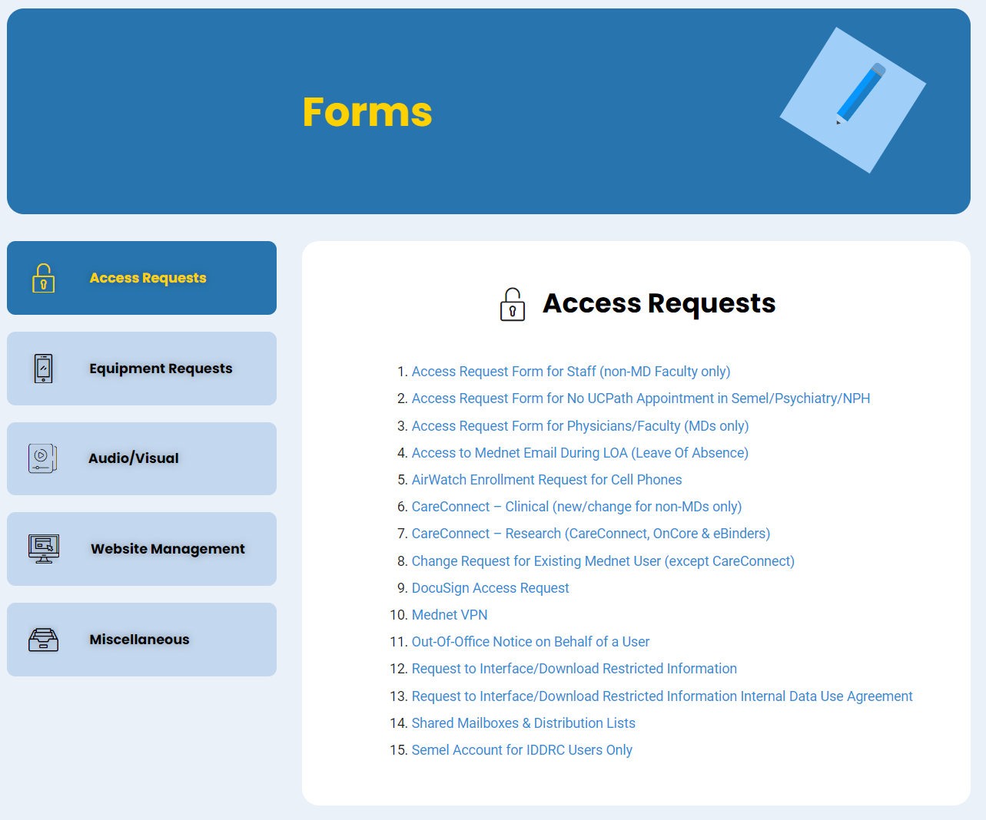
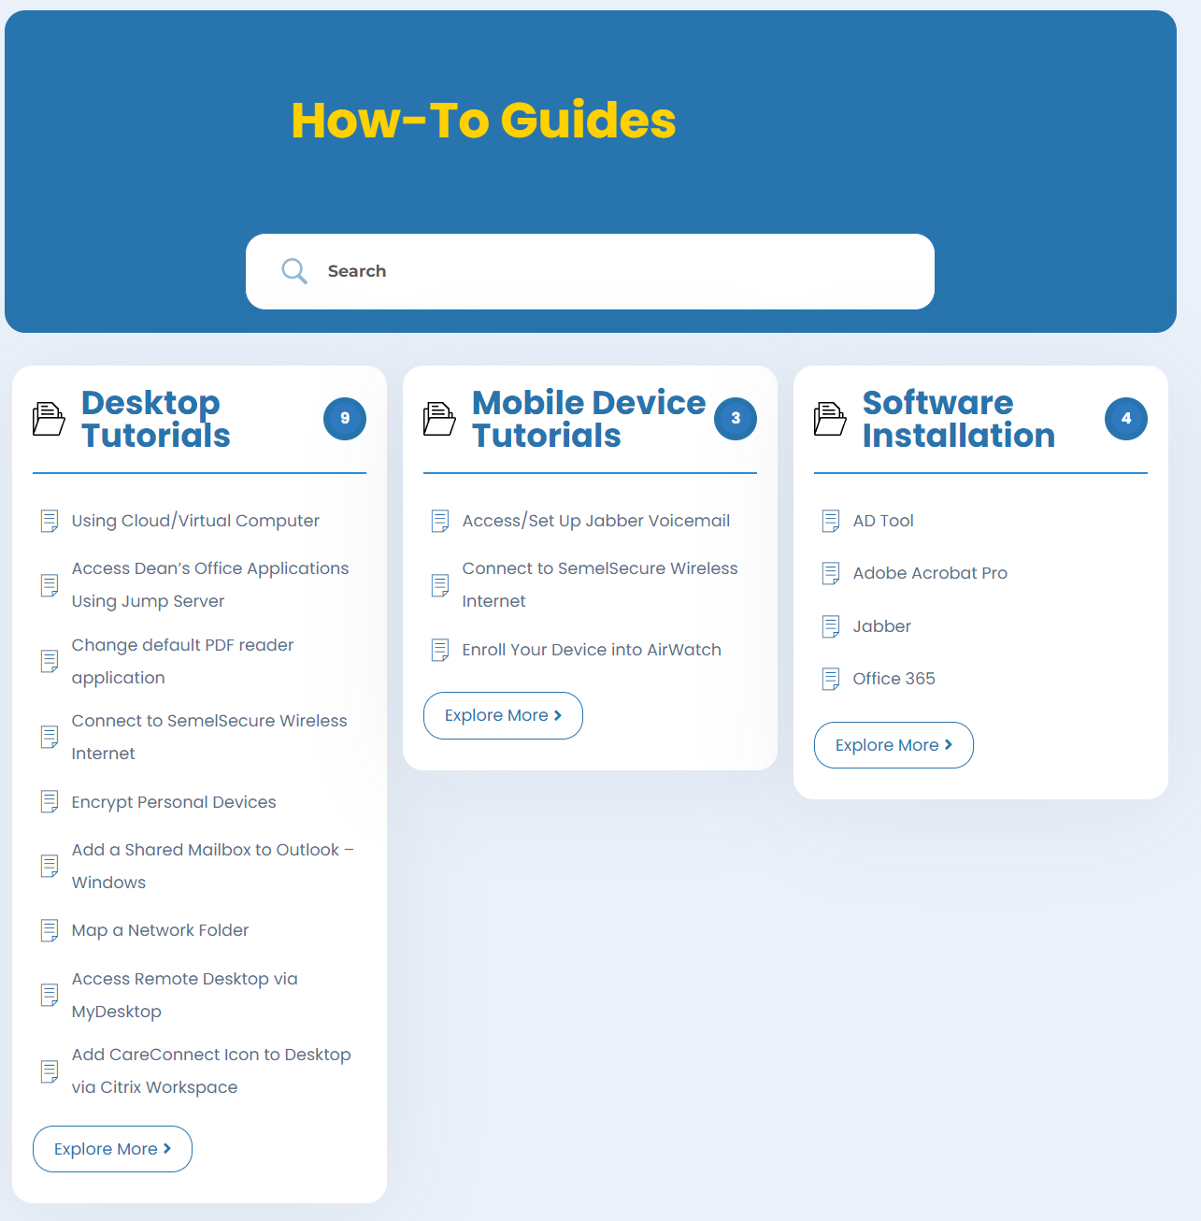
HR Points of Contact
Please visit our website for more information – IT.SEMEL.UCLA.EDU

Slide 64
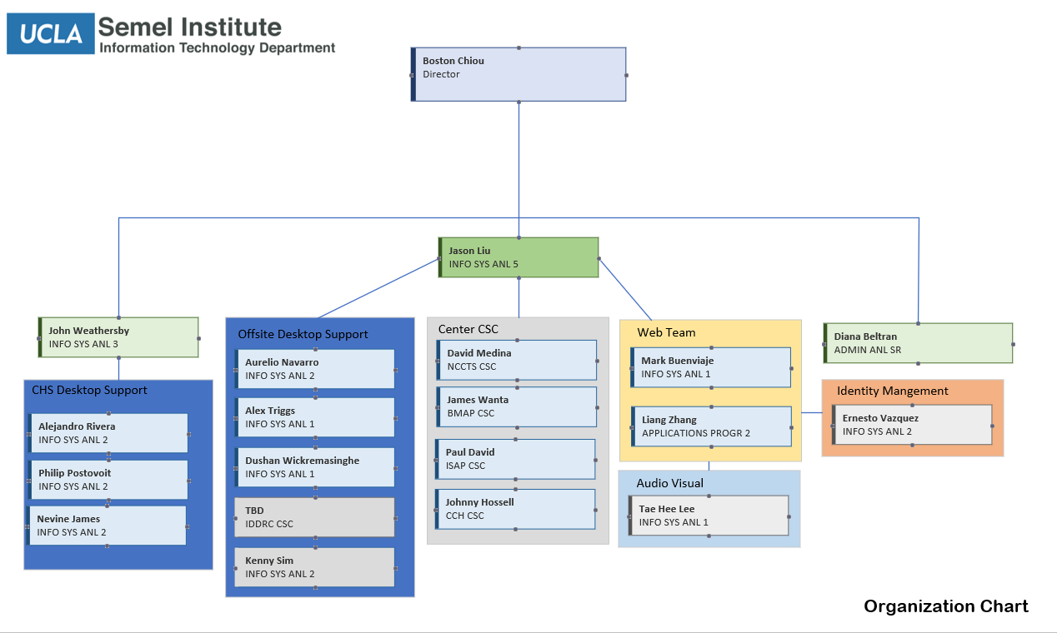
HR Points of Contact
IT Organizational Chart

Slide 65
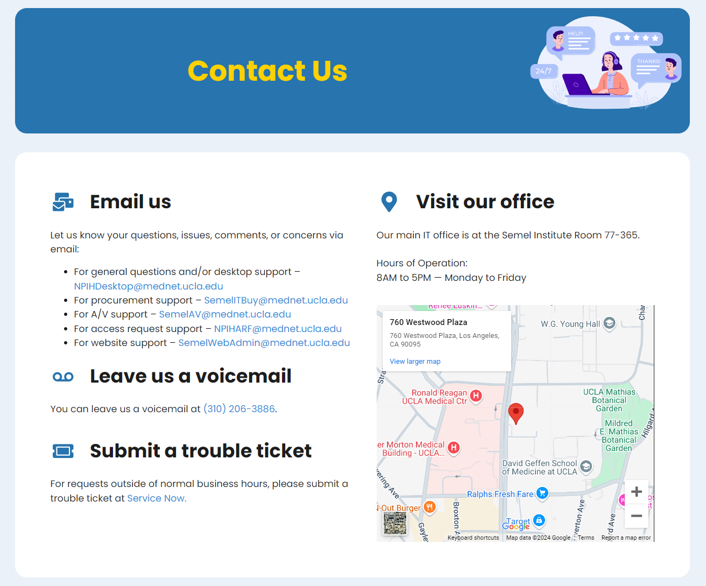
HR Points of Contact

Slide 66
Office of Extramural Support (OES)
Notes:
We strive to offer sponsored research projects with accurate, reliable, and timely post-award services using the latest policies and guidelines to advance our Institute’s mission.

Slide 67
OES Services
To provide PIs and administrators with accurate information to manage C&Gs, our fund managers:
prepare monthly financial reports
review transactions for compliance with University and Sponsor policy
assist with managing the financial aspects of an award
review prior approval requests, sponsor template invoices, and progress reports prior to forwarding to the appropriate institutional contract office for submission to sponsors
prepare financial closeout packets

Slide 68
Monthly Financial Reports
Financial reports show appropriations received, expenses incurred, and projected expenses
This information is drawn from the financial ledgers for each account-cc-fund
Fund managers send you and your PIs financial reports by the 25th of each month
Review your reports to ensure appropriate spending and update projections
Set up a quarterly meeting (monthly is preferred) to discuss reports. Communicate by phone or e-mail as needed

Slide 69
Financial Report Summary Tab*
*For more detailed information regarding monthly financial reports, click here:
(link to Appendix, OES website)

Slide 70
Financial Projections
Projections are a key component of the financial reports
As the administrator, it is important to translate information provided by PIs into budgets and the financial reports
The column highlighted in peach is where projections appear and help to estimate a project’s projected balance
Projections should continually be updated in order to maintain an accurate projected balance
The largest budgeted expense on a fund is often personnel. It is important to track personnel projections in detail

Slide 71
Prior Approval Request
Any award modification that requires sponsor approval
Examples include rebudgeting, PI change, carryforward, no cost extension, etc.
To complete a prior approval request:
complete the “Prior Approval Request” form
attach supporting documents such as a cover letter addressed to sponsor, budget, justification document, biosketch, other support
e-mail complete request to your FM for review if the request has financial implications. Your FM will forward to Award Intake for submission to the sponsor
e-mail directly to Award Intake if the request is scientific in nature and cc your fund manager.

Slide 72
OCGA Intake Teams
Contact OES before contacting the OCGA intake teams
If you have an urgent matter and need to reach out to OCGA directly, include the PATS# in the subject line
Send e-mail to | For issues related to | And cc
proposals@research.ucla.edu | Progress Reports/RPPR Revised Budget PI/Department Change | Your fund manager
awards@research.ucla.edu | Award execution Carryforward No Cost Extension Other Prior Approval Requests Relinquishment Closeout Request | Your fund manager
Notes:
Your fund manager or pre-award analyst may know the answer to your question. Your AO receives multiple requests daily. OES can help streamline the # of requests the AO receives and you may receive a response more quickly. It is important to keep OES involved with issues that affect management of your proposals and awards.

Slide 73
Progress Reports
A report submitted to the sponsor detailing progress made in the current budget period
Typically required at least annually, check the NoA
Format varies by sponsor; details can be found in the NoA
NIH progress reports are called Research Performance Progress Report (RPPR) and are either SNAP or Non-SNAP:
RPPRs should be sent to OES 3 business days prior to the NIH deadline
Your fund manager will provide information for: Participant effort table, Unobligated Balance, & Foreign spending, as well as budget review, when required (ie, P50s, Us and Ts)
SNAP eligible | Non-SNAP eligible
Due 45 days before end of current budget period | Due 60 days before end of current budget period
Carryforward is automatic | Carryforward is not automatic
The PI can submit via eRA Commons | The AO must submit on behalf of the PI

Slide 74
Financial Closeout
Award closeout refers to the final reconciliation and reporting of expenses on contracts and grants
The Closeout Packet (COP) and accompanying certification page serve as the final financial report
The FM will send a COP to the PI and administrator for review
Adjustments can be requested per the Semel Closeout Policy, otherwise they will not be processed
Once the COP is finalized, the PI must sign the certification page and submit to the FM
FM will submit to Extramural Fund Management (EFM) for review and submission to sponsor
Final closeout due date varies by sponsor and the COP is due internally to EFM in advance (ie, NIH is due 120 days after fund end date, but due to EFM 90 days after fund end date)

Slide 75
OES Organizational Chart
Elizabeth Gillespie
Interim Director
Hari Wijesekera
Assistant Director
Gladys Carrera
Operations Analyst
Amy Ye
Team 1 Supervisor
Thao Nguyen
Team 2 Supervisor
Jeremiah Briones
Sr. Fund Manager
Fernando Rodriguez
Sr. Fund Manager
Amisha Singh
Sr. Fund Manager
Irene Wang
Sr. Fund Manager
Dan Castillo
Sr. Fund Manager
Albertina Samardzic
Sr. Fund Manager
Lorena Vazquez
Sr. Fund Manager
Michael Tabe
Fund Manager
Briana Serrano
Fund Manager

Slide 76
OES Directory
Name | Role | Email
Elizabeth Gillespie | Interim Director | ELizaola@mednet.ucla.edu
Hari Wijesekera | Assistant Director | HWijesekera@mednet.ucla.edu
Amy Ye | Team 1 Supervisor | MYe@mednet.ucla.edu
Thao Nguyen | Team 2 Supervisor | ThaNguyen@mednet.ucla.edu
Jeremiah Briones | Sr. Fund Manager Team 1 | JGBriones@mednet.ucla.edu
Gladys Carrera | Operations Analyst | GCarrera@mednet.ucla.edu
Dan Castillo | Sr. Fund Manager Team 2 | DenilleCastillo@mednet.ucla.edu
Fernando Rodriguez | Sr. Fund Manager Team 1 | FeRodriguez@mednet.ucla.edu
Albertina Samardzic | Fund Manager Team 2 | ASamardzic@mednet.ucla.edu
Briana Serrano | Fund Manager Team 2 | BTSerrano@mednet.ucla.edu
Amisha Singh | Sr. Fund Manager Team 1 | ALSingh@mednet.ucla.edu
Michael Tabe | Fund Manager Team 1 | MTabe@mednet.ucla.edu
Lorena Vazquez | Sr. Fund Manager Team 2 | LVazquezSong@mednet.ucla.edu
Irene Wang | Sr. Fund Manager Team 1 | IWang@mednet.ucla.edu

Slide 77
Notes:
To accelerate advancements in research by supporting the Semel community in identifying and translating research opportunities into awards through strategic planning efforts and enhanced training, support, and collaboration.

Slide 78
OROS Services
Pre-award Team: Manages proposal intake and review, as well as system access
Research Strategy & Support Team: Supports proposal preparation for PIs without administrators or those who need extra support
The OROS team can be reached via email at: preaward@mednet.ucla.edu
Training and Education Team: Creates training materials and provides consultation
Visit our website to access helpful information and resources: https://oros.semel.ucla.edu/

Slide 79
Pre-award Services
To provide reliable and accurate pre-award support, OROS:
Interprets and disseminates University and Sponsor policy
Develops tools including checklists, tip sheets, and templates
Offers consultation sessions to assist with proposal preparation
Reviews proposals to ensure compliance with policy
Prepare
PI & Administrator
Review
Pre-Award
Submit
Pre-Award / contract office

Slide 80
Proposal Submission Timeline
E-mail preaward@mednet.ucla.edu as soon as you think you may be submitting a proposal
Subject: PI Last Name-Sponsor & Type DUE DATE
Attach, or include a link to, the funding opportunity announcement
DUE 8 business days before sponsor deadline:
- NIH proposals exceeding $500K DC per budget period
- non-NIH proposals
DUE 5 business days before sponsor deadline:
- NIH Proposals ≤ $500K DC per budget period

Slide 81
Minimum Documents
For Review
Completed EPASS, with the following attached:
Sponsor guidelines
Sponsor forms that require OCGA signature
Budget & Justification, including internal excel
Draft Abstract
If UCLA will be issuing a sub, a final subaward packet
For Cayuse Submissions, all sections must be final except the Specific Aims, Research Strategy, and References
NOTE: If UCLA is a sub to another institution, all prime requested documents are needed to initiate review
For Approval and Submission
All of the above, plus final proposal, signed conflict of interest forms, and PI exception letter (if applicable)

Slide 82
Favorable Review
For NIH proposals:
- if you receive a good score, start working on the IRB if you have human subjects or IACUC for animal subjects
- a Just-in-Time (JIT) will be requested, which typically requires:
other support pages
IRB or IACUC approval
proof of human subjects training
in some cases, additional items may be requested
For non-NIH proposals, as soon as you receive a positive indication of funding or award notification, start working on the IRB or IACUC

Slide 83
Award Numbers / Identifiers
PATS, Award, Fund, FAU
Once a proposal is submitted to contracting office, it will be assigned a PATS #
Should the proposal be awarded, the PATS # will be the common # used across UCLA offices to track the award
Award # is often used by sponsor, PI, and OCGA
Fund # and FAU is used by fund managers and EFM
Number Type | Example
PATS | 20234260
Award | R01MH123456
Fund | 12345
FAU | 441587-CC-12345

Slide 84
OROS Organizational Chart
Elizabeth Gillespie
Director
Mary Moried
CT Consultant
Joe Mango
Training Consultant
Anna Lau
Research Strategy & Support Lead
Michael Rastadmehr
Business Applications Lead
Judy Sharinger
Pre-award Analyst
Lauren Kawaguchi
Grant & CT Analyst
Joseph Pobee
Pre-award Research Admin

Slide 85
OROS Directory
Name | Role | Email
Elizabeth Gillespie | Director | elizaola@mednet.ucla.edu
Lauren Kawaguchi | Grants & CT Analyst | lkawa@mednet.ucla.edu
Anna Lau | Research Strategy & Support Lead | amlau@mednet.ucla.edu
Joseph Pobee | Pre-Award Research Administrator | jpobee@mednet.ucla.edu
Judy Sharinger | Pre-Award Analyst | jsharinger@mednet.ucla.edu

Slide 86
Facilities and Space Planning
Notes:
We strive to offer sponsored research projects with accurate, reliable, and timely post-award services using the latest policies and guidelines to advance our Institute’s mission.

Slide 87
Role of the Facilities & Space Planning Team
To provide a safe and functional environment in buildings for delivery of research, teaching, patient care, and public services by providing the following services :
Housekeeping (Semel, 300 Medical Plaza, Resnick Hospital)
Building maintenance (Moving services, minor carpentry, paint, electrical, plumbing, thermostat adjustment)
Mail/receiving (Semel, 300 Medical Plaza, NRB)
Office and Laboratory Keys and Door Signage (Semel, 300 Medical Plaza, NRB)
Panic button installation and trouble shooting (Semel, 300 Medical Plaza)
Coordination for Safety and Biosafety of all spaces in buildings with Semel institute Department of psychiatry faculty, staff, trainees and visitors
Conference room booking (Semel, 300 Medical Plaza-Marisa Leif Conference Room)
Space Planning/Space Committee
Coordination with Campus Facilities (electrical, plumbing, HVAC, fire alarms, and elevators
Space planning to include needs of furniture and equipment for offices, wet/dry laboratories, testing and consultation spaces, and public spaces
Coordination with campus Real Estate Office for space acquisition
Orientation/On-Boarding for new faculty and staff
Space Inventory
Commissioning and decommissioning of wet bench laboratories

Slide 88
How to Request Services from Semel Facilities
Housekeeping – Email Sailesh Pal SPal@mednet.ucla.edu
Building maintenance (Moving services, minor carpentry, paint, electrical, plumbing, thermostat adjustment) Email Efrain Solares, ESolares@mednet.ucla.edu
Mail/receiving (Semel, 300 Medical Plaza, NRB) – Email Semelfacilities@mednet.ucla.edu, for individual
Office and Laboratory Keys and Door Signage (Semel, 300 Medical Plaza, NRB) Email Oscar Dominguez ODominguez@mednet.ucla.edu and William Naidu WilliamNaidu@mednet.ucla.edu
Panic button installation and trouble shooting (Semel, 300 Medical Plaza)- Email Semelfacilities@mednet.ucla.edu
Coordination for Safety and Biosafety of all spaces in buildings with Semel institute Department of psychiatry faculty, staff, trainees and visitors – Email Xiaoyu (Alex) Wu, XiaoyuWu@mednet.ucla.edu
Conference room booking (Semel, 300 Medical Plaza-Marisa Leif Conference Room)
Space Planning/Space Committee – Email Oscar Dominguez ODominguez@mednet.ucla.edu and William Naidu WilliamNaidu@mednet.ucla.edu

Slide 89
How to Request Services from Semel Facilities (continued)
9. Coordination with Campus Facilities (electrical, plumbing, HVAC, fire alarms, and elevators) – Email Semelfacilities@mednet.ucla.edu
10. Space planning to include needs for offices, wet/dry laboratories, testing and consultation spaces, and public spaces – Email Steven Fulton SMFulton@mednet.ucla.edu, Evelyn Cederbaum EJCederbaum@mednet.ucla.edu, and Barry Ayala, Barryayala@mednet.ucla.edu
11. Coordination with campus Real Estate Office for space acquisition – Email Steven Fulton SMFulton@mednet.ucla.edu and Evelyn Cederbaum EJCederbaum@mednet.ucla.edu
12. Orientation/On-Boarding for new faculty and staff- Email Steven Fulton SMFulton@mednet.ucla.edu and Evelyn Cederbaum EJCederbaum@mednet.ucla.edu
13. Space Inventory - Email Steven Fulton SMFulton@mednet.ucla.edu, Evelyn Cederbaum EJCederbaum@mednet.ucla.edu, and Barry Ayala Barryayala@mednet.ucla.edu
14. Commissioning and decommissioning of wet bench laboratories - Email Steven Fulton SMFulton@mednet.ucla.edu, Evelyn Cederbaum EJCederbaum@mednet.ucla.edu, Xiaoyu (Alex) Wu XiaoyuWu@mednet.ucla.edu
15. Recycled Furniture – Email Efrain Solares ESolares@mednet.ucla.edu and Barry Ayala barryayala@mednet.ucla.edu

Slide 90
Facilities & Space Planning Organizational Chart
Steve Fulton
Director of Semel Facilties and Space Planning
Roel Ophoff
Chair of the Semel Institute Safety Advisory Committee
Andrei Roudenko
EVS Director (Resnick)
Oscar H. Dominguez
Administrative Assistant III
Xiaoyu (Alex) Wu
EHS Coordinator; Biosafety officer
Barry Ayala
Associate Planner; Space Planning
Efrain Solares
Building Management Service Officer
Salish Pal
Prin Custodian Supervisor
William Naidu
Administrative Assistant II
Walter Cabrera
Lead Facilities Mechanic
Michael Munoz
Facilties Worker
Evelyn Cederbaum
Assoc. Director (on-recall)
Key Requests
Room Booking
Panic Button Requests
FSR Requests
Key Requests
Conference Room Booking
Room Booking
Mail Distribution
Service Requests

Slide 91
Facilities and Space Planning Directory
Name | Role | Email | Phone
Steven Fulton | Director | SMFulton@mednet.ucla.edu | 310-206-8819
Evelyn Cederbaum | Assoc. Director (on recall) | EJCederbaum@mednet.ucla.edu ejcederbaum@g.ucla.edu | 310-968-5134
Xiaoyu (Alex) Wu | Biosafety Officer | XiaoyuWu@mednet.ucla.edu | 310-267-5603
Sailesh Pal | Custodian Supervisor | SPal@mednet.ucla.edu | 310-825-0396
Jairo Hernandez | Evening Custodian Supervisor | JSHernandez@mednet.ucla.edu | 310-825-0396
Efrain Solares | Building Manager | ESolares@mednet.ucla.edu | 310-267-0093
Barry Ayala | Associate Planner | Barryayala@mednet.ucla.edu | 310-825-5609
Walter Cabrera | Lead Facilities Mechanic | WLCabrera@mednet.ucla.edu | 310-825-0160
Michael Munoz | Facilities Worker | MAMunoz@mednet.ucla.edu | 310-825-0160
Oscar Dominguez | Admin. Asst. III | ODominguez@mednet.ucla.edu | 310-825-0573
William Naidu | Admin. Asst. II | WilliamNaidu@mednet.ucla.edu | 310-825-0573

Slide 92
Important Contacts
If there is an emergency call 911. Info about when to call 911
UCLA Facilities Management Service Request — for building issues or to schedule work, call 310- 825-9236 or use 311 app or Service Request online
UCLA Health Security — 310-267-7100
DGIT Support — call x7-CARE (7-2273) or 310-267-2273
EH&S Hotline — call 310-825-9797 to report serious injuries
UCPD — 310-825-1491 Info about when to use the UCPD Business line
Once you have contacted the number above please notify Semel Facilities at Semelfacilities@mednet.ucla.edu

Slide 93
THANK YOU!
If you have questions, contact: OROS
OROS@mednet.ucla.edu

Slide 94
Useful Links to Central Offices
OFFICE | ROLE | LINK
Office of Contract and Grant Administration (OCGA) | Assists in reviewing, approving, and submitting proposals and negotiating / executing contracts & grants from government and non-profit sponsors. | http://ocga.research.ucla.edu
Office of the Human Research Protection Program (OHRPP) | Responsible for ensuring the safety and welfare of participants involved in human research projects, in partnership with the research community. | http://ohrpp.research.ucla.edu
Research Safety & Animal Welfare Administration (RSAWA) | Supports the safety of workers and the environment, the physical security of research areas and the welfare of laboratory animals. | http://rsawa.research.ucla.edu
Extramural Fund Management (EFM) | Provides financial management support of sponsored project funds. | http://efm.research.ucla.edu
Clinical Trials Contract & Strategic Relations (CTC&SR) | Supports matters related to clinical trials and industry sponsor contracting. | http://clinicaltrials.ucla.edu/body.cfm?id=74
Technology Development Group (TDG) | Assists in managing agreements with for-profit industry sponsors, invention disclosures, material transfer agreements. | https://tdg.ucla.edu
Research Policy & Compliance (RPC) | Provides leadership in shaping, interpreting and implementing UC and UCLA research-related policies, procedures and guidance. | http://rpc.research.ucla.edu
Insurance & Risk Management (IRM) | Provides risk management programs and services including Workers' Compensation, claims processing and training in insurance and risk matters. | https://irm.ucla.edu/
Payment Solutions & Compliance | Provides policies and forms on topics ranging from human subjects disbursements to employee recognition and reward program. | https://www.finance.ucla.edu/business-finance-services/payment-solutions-and-compliance
Corporate Accounting | Instructions and guidance for financial procedures, financial reports, along with training and tutorials for University Accounting and financial System Applications. | https://www.finance.ucla.edu/corporate-accounting
UCLA CTSI Research GO | Provides a single portal to resources, expertise and best practices regarding study design, implementation and close out. | https://www.researchgo.ucla.edu/
Research Enhancement Office - Limited Submissions | Provides an overview on how limited submission opportunities are handled, along with a portal listing open, extended and closed limited submission opportunities. | https://research.ucla.edu/reo/lso

Slide 95
Other Useful Links & Listservs
Roles & Responsibilities Worksheet: https://oros.semel.ucla.edu/rolesandresponsibilities/
Office of Research Administration (ORA) Portal: http://portal.research.ucla.edu/
UC Payroll, Academic Personnel, Timekeeping and Human Resources (UCPath): https://www.cru.ucla.edu/home
Research Administration Forum (RAF): https://ora.research.ucla.edu/raf/
Department of Medicine’s Fund Management Training Site: https://medschool.ucla.edu/research/researcher-resources/administrative-support/department-medicine-office-research-administration/fund-management-training
Listservs:
Administrator Work Group (AWG): email Jason Liu, JALiu@mednet.ucla.edu to be added to this
Office of Research Administration (ORA) news: https://form.research.ucla.edu/ora/ora-news-subscription/
Administrative Management Group (AMG): https://docs.google.com/forms/d/e/1FAIpQLSf7qXjvmOhZTSh-XCLIYKBeAKDkh__6B4LeOU1OwVVYUsMA8g/viewform

Slide 96
Helpful Contacts Directory
Enter contact info for senior administrators that agree to serve as mentors?

Slide 97
UCLA Perks
Free lectures/workshops
University Extension discounts
Other Discounts:
Westwood Village
Central Ticket Office
Cell & Computer
Transportation
https://campusservices.ucla.edu/discounts
Tuition discounts
BruinErgo
FITWELL

