Slide 1
NIH Updates- Practical Use
June 25, 2026
DMSP new template
EPASS/Cayuse Hot Tip
Cayuse Validations

Slide 2
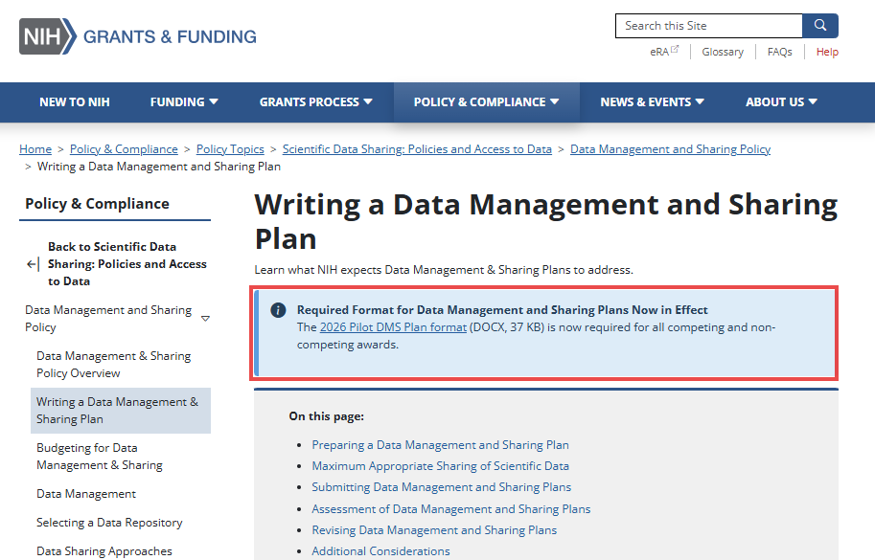
Data Management and Sharing Plan
New Format Page(s)
Quick Facts
New DMSP format pages- REQUIRED for all submissions as of May 2026
Two pages
Available from NIH as a Word doc (or ask me!)
7 questions
  #1-4 are Yes/No
  #5-7 may or may not be applicable
  #6 is a table
Notes:
Writing a Data Management and Sharing Plan | Grants & Funding

Slide 3
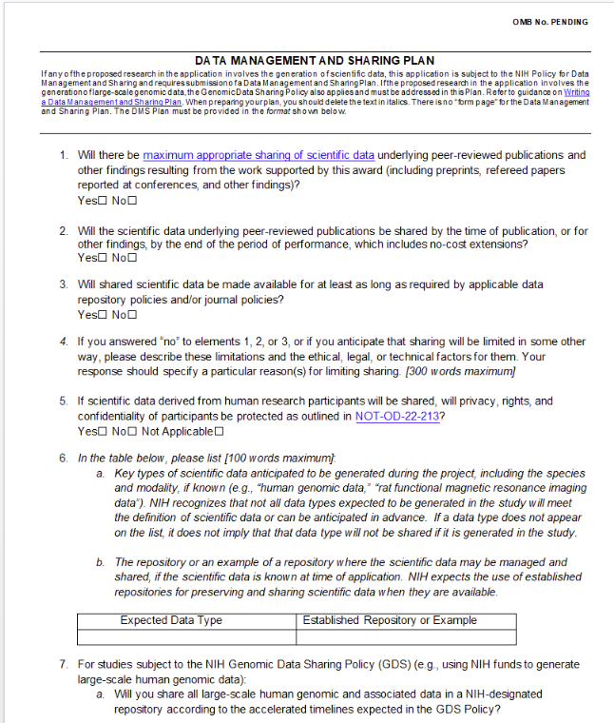
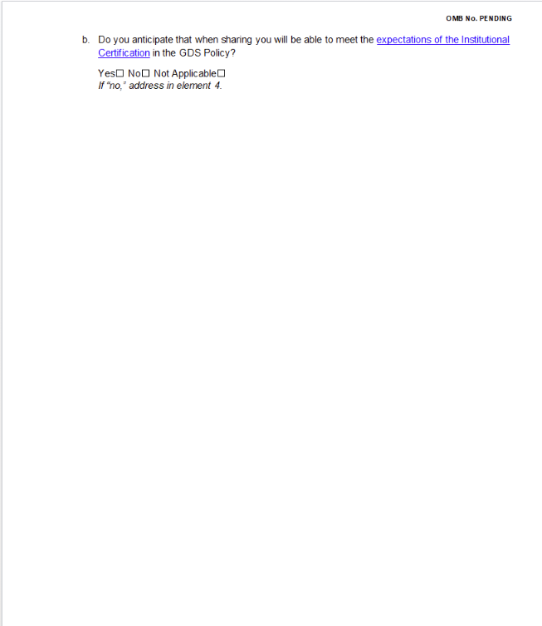
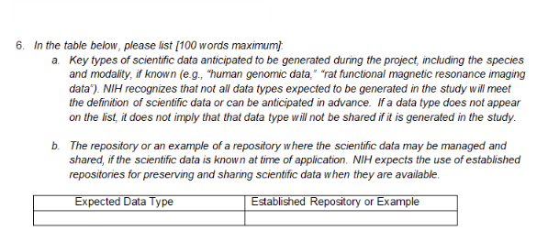
New DMSP

Slide 4
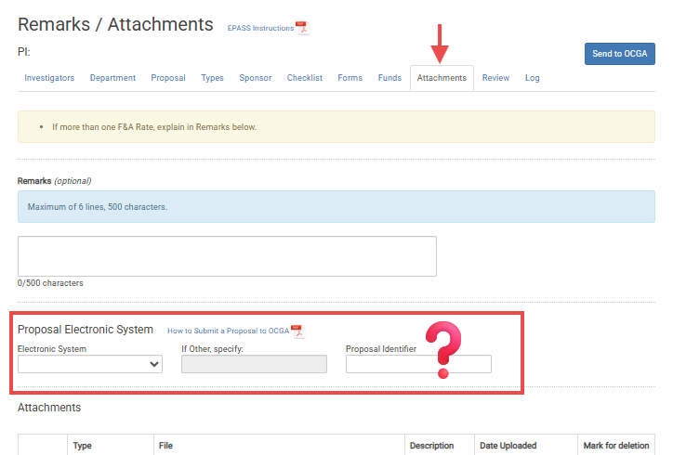
EPASS- what is a Cayuse Identifier???

Slide 5
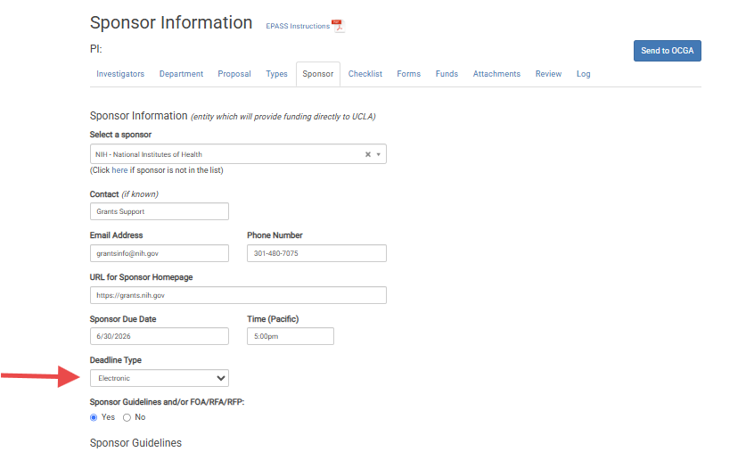
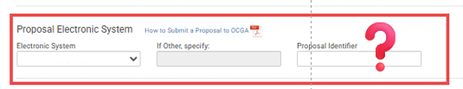
What? And Why?
In the Sponsor Information tab:
The deadline type gives you a few options
Choosing “Electronic” makes the response on the Attachments tab required

Slide 6
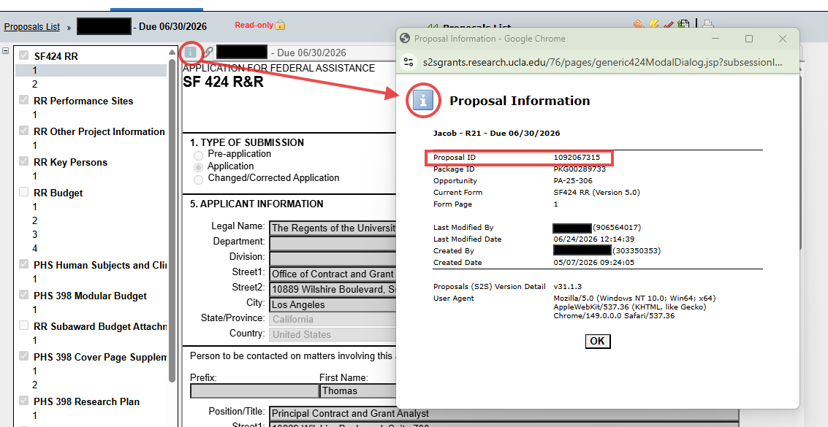
Cayuse calls it the “Proposal ID”

Slide 7
Cayuse “Proposal ID”
Do I have to?
Yes!
WHY??
- If you identify that a sponsor requires submission electronically, OCGA needs to know about it. The “Electronic System” dropdown gives you options- either a system we are VERY familiar with, or a write in “Other” option, that we may or may not know so well!
But, WHY??
Giving OCGA the system, and then proposal ID information, ensures they can access the system, provide any internal signatures/approvals required, and can verify all final versions
ALSO! Once you enter the electronic system AND Proposal ID- you no longer have to upload the “Proposal” attachment- because OCGA will be able to find it, in the most complete form, from the sponsor’s submission site!

Slide 8
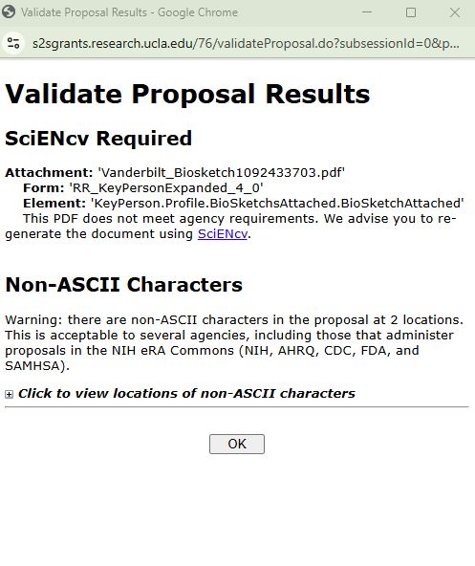
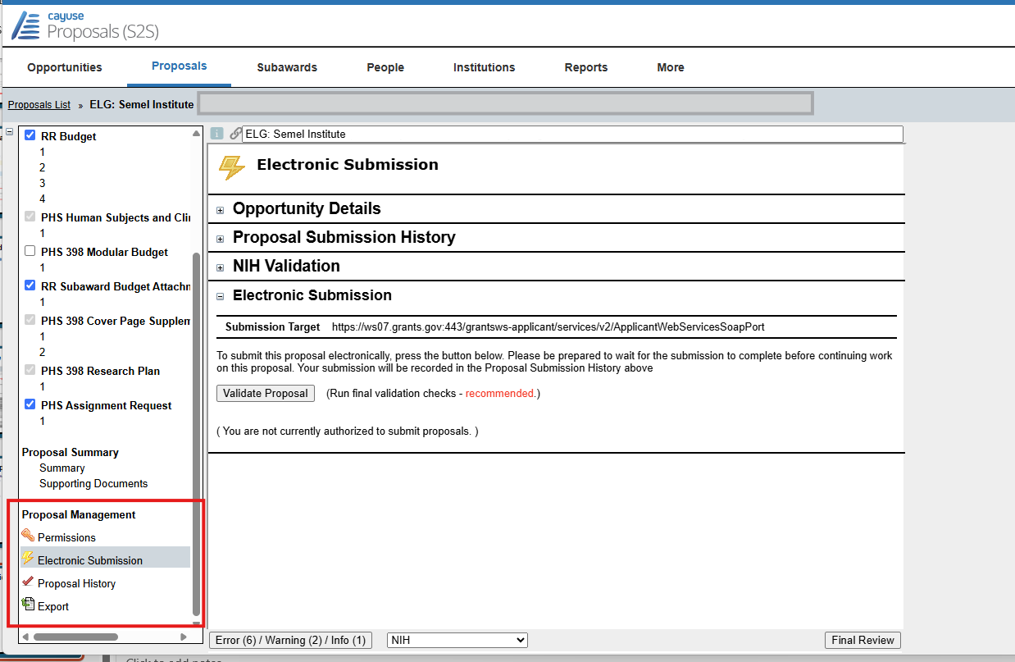
Cayuse Validations

Slide 9
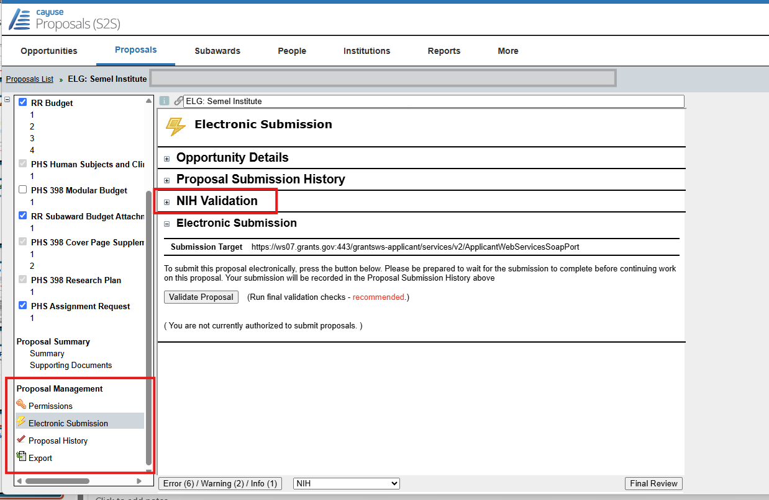
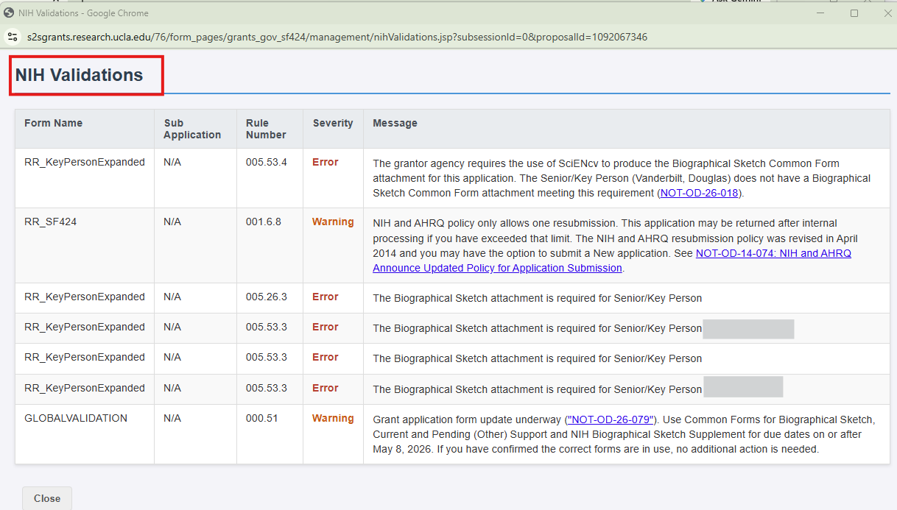
NEW NIH Validation!

